Slide 1
MIS in Industry
Imran Mahmud

Slide 2
Enterprise system
Enterprise systems (ES) provide enterprise wide support and data access for a firm’s operations and business processes.
Enterprise application integration (EAI): Connects the plans, methods, and tools aimed at integrating separate enterprise systems . SAP Exchange Infrastructure, Tibco, BizTalk, oracle fusion.
Integrate systems that were not designed to work together
Accommodate various elements of information technology that may be dissimilar and incompatible

Slide 3
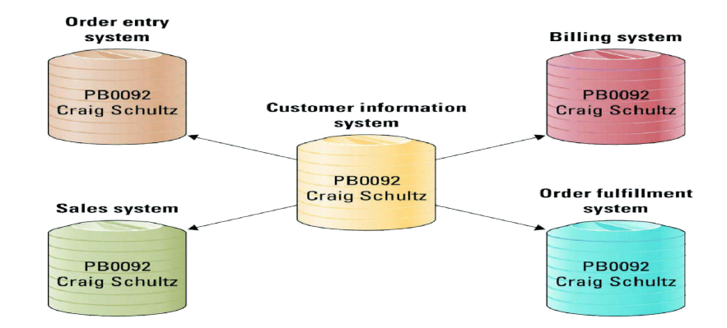

Slide 4
Middleware: Several different types of software that sit between and provide connectivity for two or more software applications
Database access technology - e.g ODBC (Open DataBase Connectors)
Java’s database connectivity API : JDBC
Remote computation products - e.g ONC RPC, OSF RPC and RMI (Java Remote Method Invocation)
Distributed Computing Environment (DCE) products, Common Object Request Broker Architecture (CORBA), Distributed Component Object Model (DCOM)

Slide 5
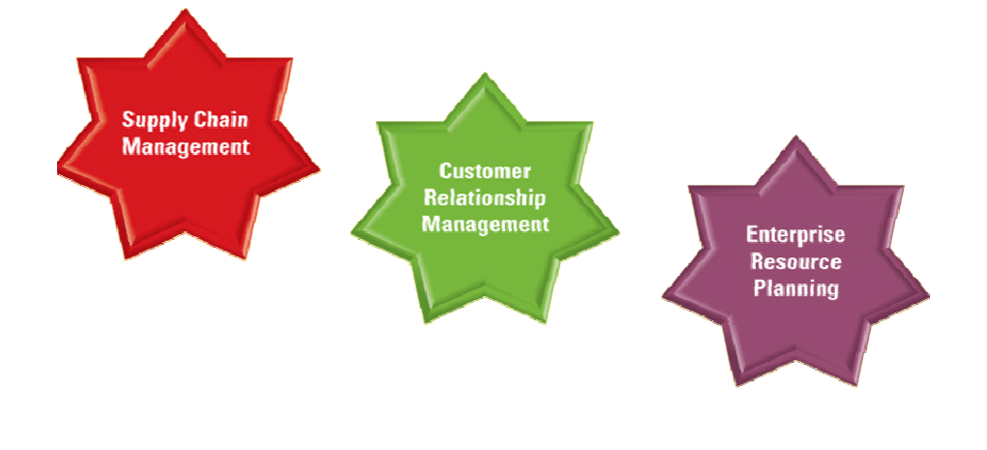
Three Primary Enterprise Systems

Slide 6
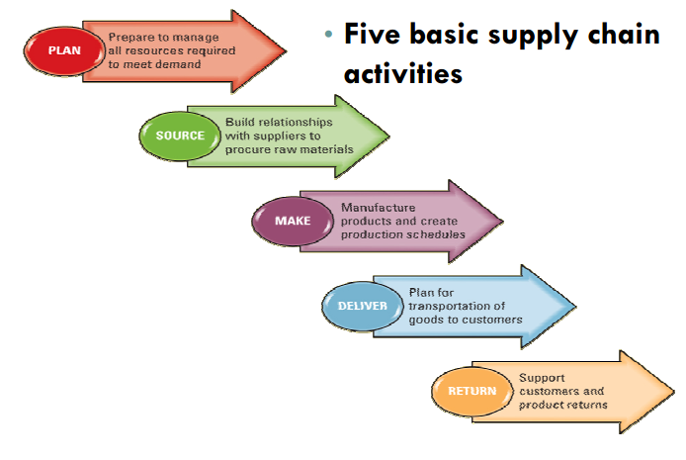
Supply chain management

Slide 7
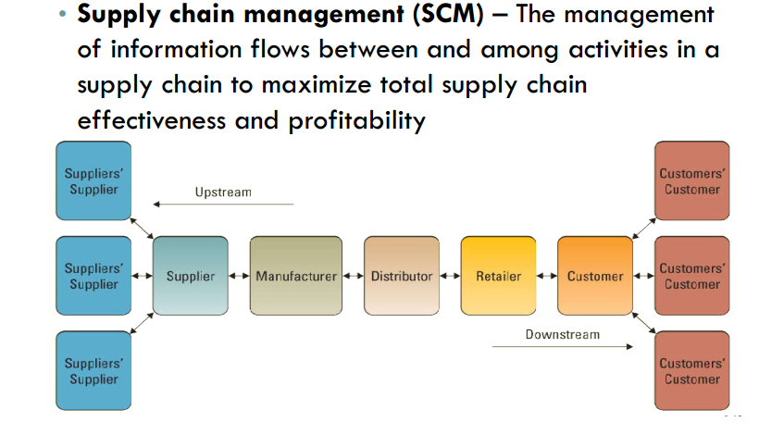

Slide 8
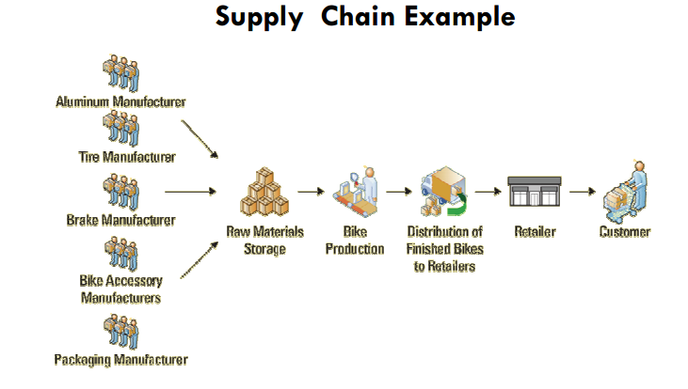

Slide 9
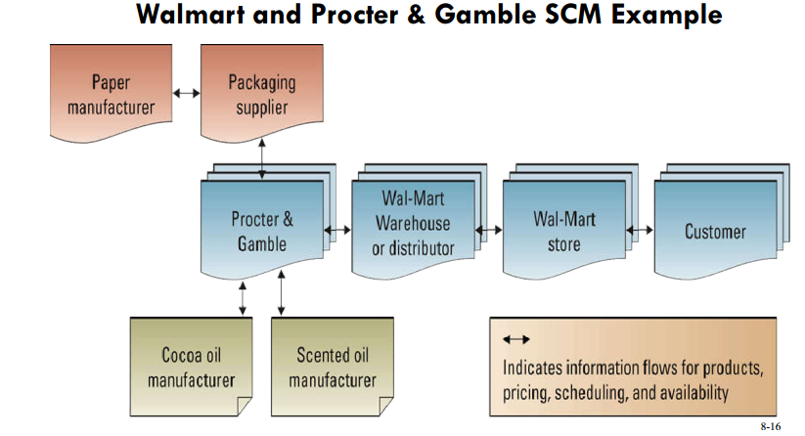

Slide 10
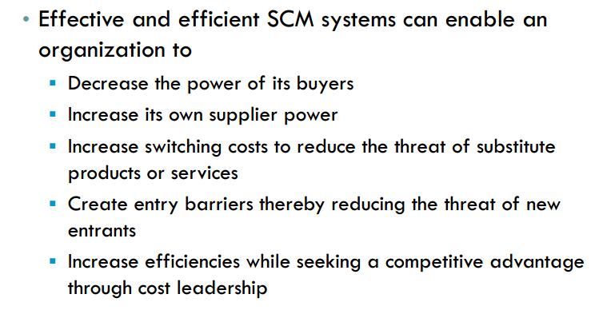
Benefits of SCM

Slide 11
Customer relationship management
Customer relationship management (CRM) – Involves managing all aspects of a customer’s relationship with an organization to increase customer loyalty and retention and an organization's profitability • Many organizations have obtained great success through the implementation of CRM systems

Slide 12
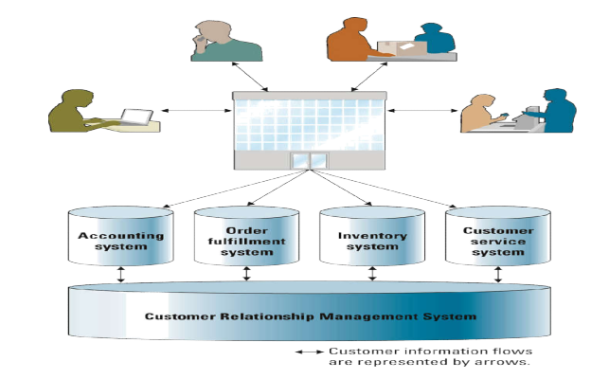
CRM

Slide 13
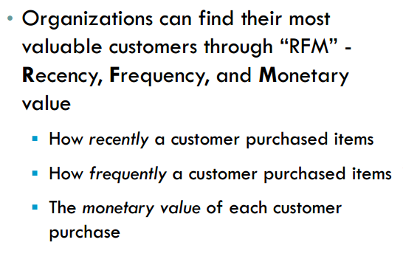
Benefits of CRM

Slide 14
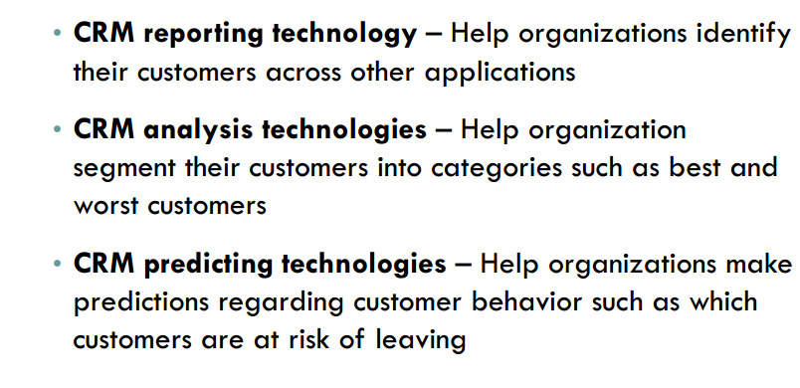
Types of CRM

Slide 15
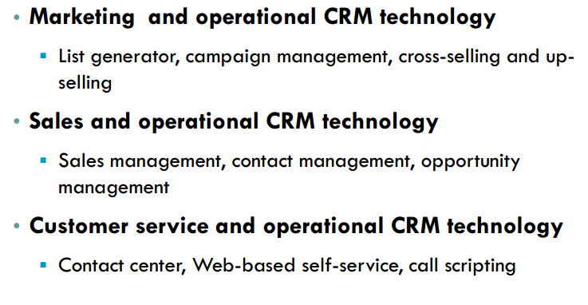

Slide 16
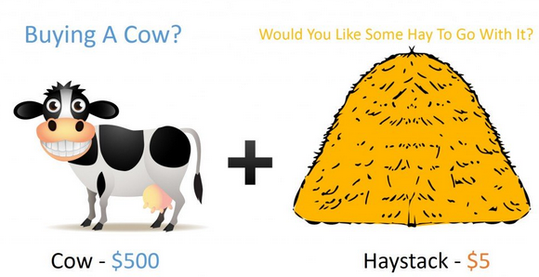
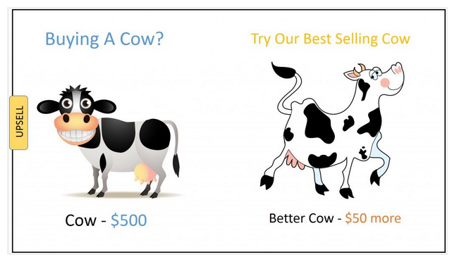
Cross sell vs Up sell

Slide 17
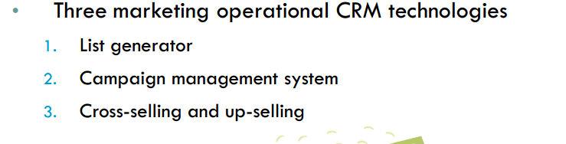
Marketing

Slide 18
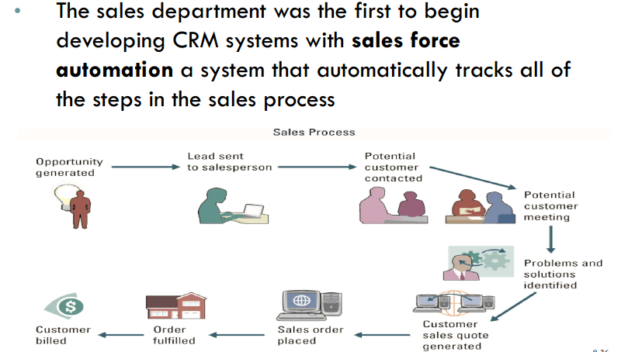
Sales CRM

Slide 19
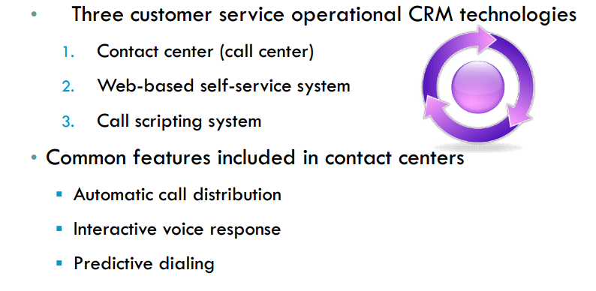
Customer Service CRM

